Slide 1
Airbnb: European City Comparison (Amsterdam, London and Paris)
Dayana Iciano, Rina Bitas and Andrei Tabatchouk

Slide 2

Contents
Objective and Data Sourcing
Analysis
Dayana input
Distance to City Center
Distance to Nearest Metro
Average Price per Room Type
Listings by Room Type
Cleanliness vs Guest Satisfaction Correlation
Conclusions
Q & A

Slide 3
Objectives and Data Sourcing
Compare and contrast cities based on location, accessibility and accommodations
Price comparison between Weekdays and Weekends for each city
Cost comparison between number of bedrooms and price
Does price and distance to city center correlate
Accessibility to metro in each City
Comparison of room type options between Amsterdam, London, and Paris
In General, does cleanliness and guest satisfaction have a correlation for Airbnb's
Data sourcing
Kaggle.com
6 different CSV files looking at weekend and weekday rates/availability
Leveraging price, bedroom count, distance to city center, nearest metro, cleanliness, guest satisfaction, and Airbnb type

Slide 4
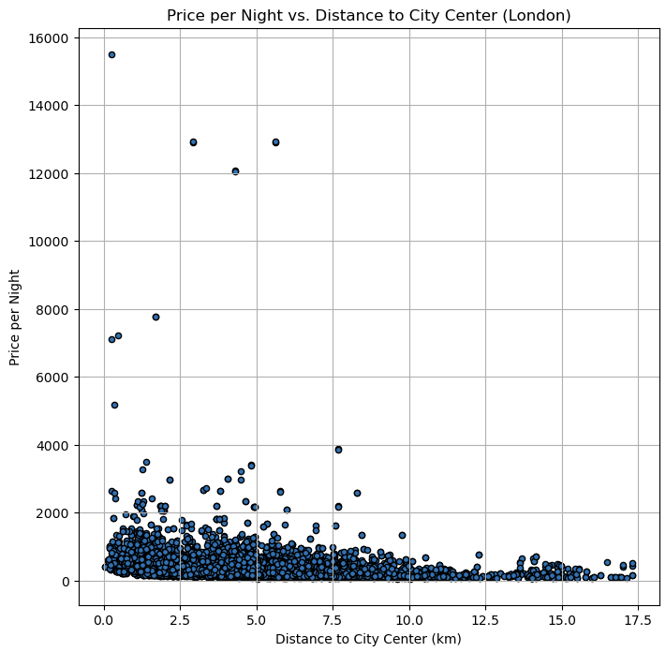
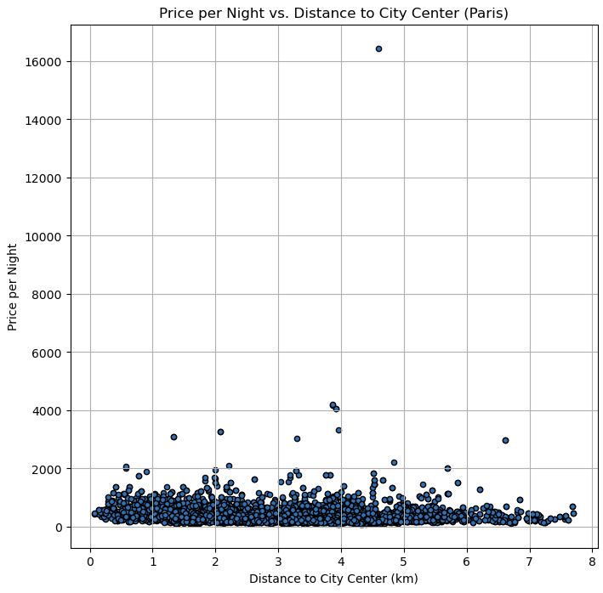
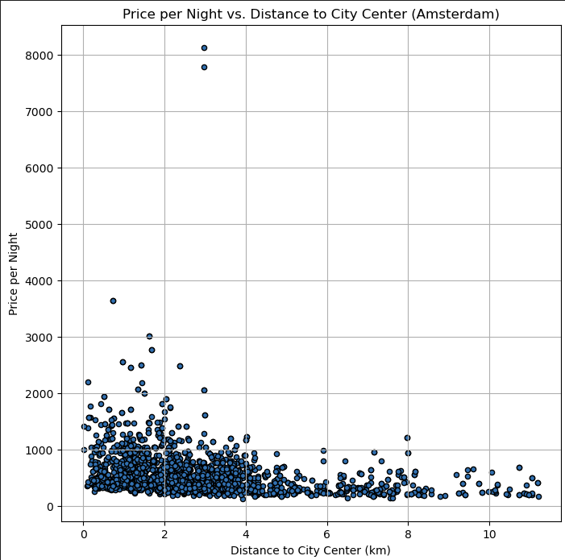
Distance to City Center
Amsterdam average price per night is 573.11, far exceeding the average price to London (362.47) and Paris (392.53)
The average distance to city center is the lowest in AMS (2.83km)
The Amsterdam scatter plot shows a higher concentration on the left closer to the y-axis
Paris has a symmetrical distribution when it comes to distance to city center (2.99km average and median)
Distance to city center isn’t that much of a factor to price compared to Amsterdam and London

Slide 5
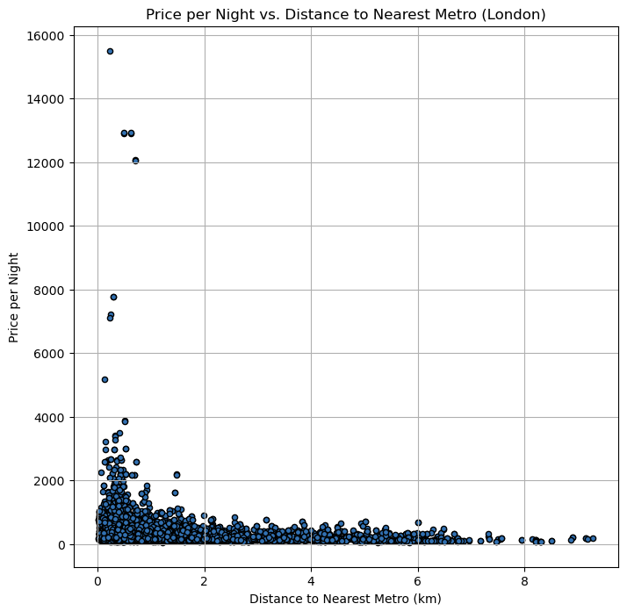
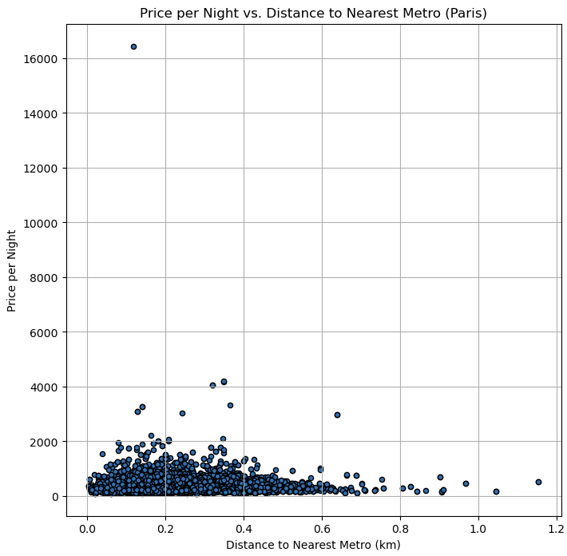
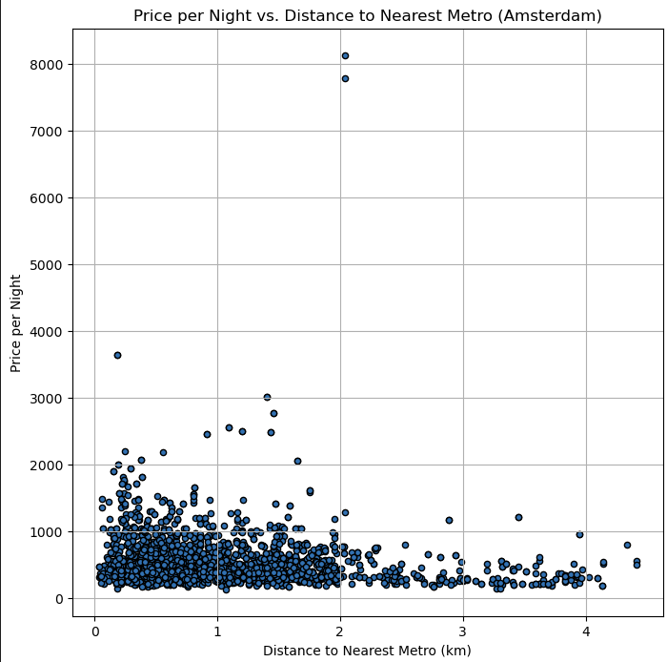
Distance to Nearest Metro
Paris has the most accessibility to metros with an average distance of 0.23 km
Accessibility in London plays a bigger factor in price
Prices taper off significantly around the 2 km mark
In Amsterdam, prices and availability drops after 2 km or more to the nearest metro station

Slide 6
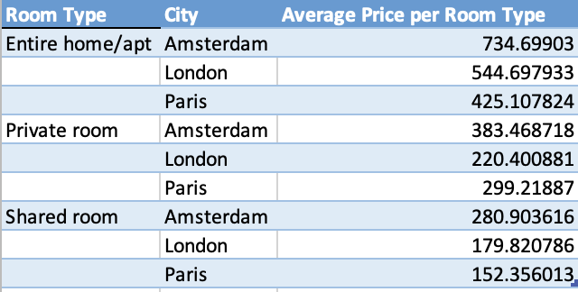
Average Price Per Room Type
Amsterdam prices are significantly more expensive than London or Paris
Booking an entire home or apartment will cost more than a shared room across all three cities
Booking an entire home/ apartment in Amsterdam is more expensive

Slide 7
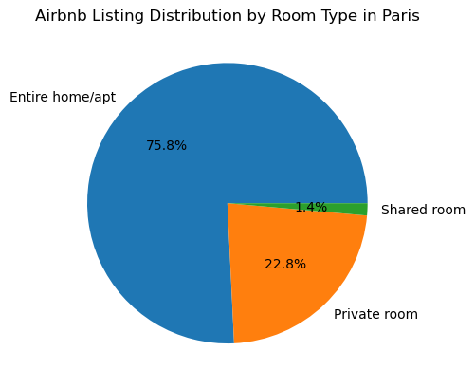
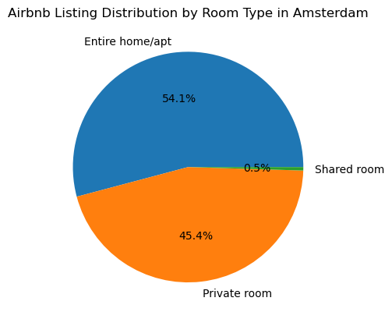
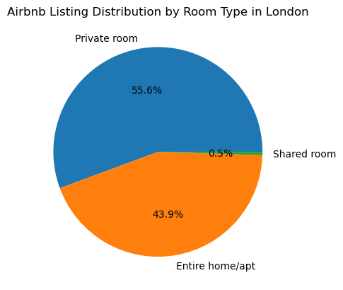
Listings by Room Type for Each City
Amsterdam and Paris have very similar distributions of room types offered
Paris has an overwhelming number of entire home/ apartments offered
Shared rooms are not common in all three cities

Slide 8
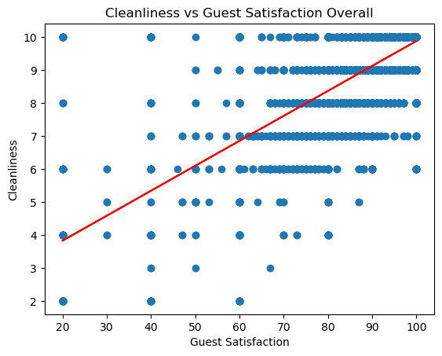
Cleanliness vs Guest Satisfaction
correlation between cleanliness and guest satisfaction yields a strong r value of 0.72
If an Airbnb is ranked highly in the cleaning aspect it is mostly likely it will get a high guest satisfaction rating.

Slide 9
Conclusions
Amsterdam typically will cost visitors more across the board compared to visiting London and Paris for lodging.
Distance to the city center does play a factor in price in Amsterdam and London. The average price is higher if you want to be within 4-5 km. In Paris, there is an even distribution, so travelers can find wider range of options at various costs regardless to distance.
In terms of accessibility to metro, Paris offers easier access with an average metro stop around 0.22 km. Travelers on a budget will not have to worry about finding an Airbnb far away from the metro
When looking for Airbnb's in Paris, entire homes/ apartments will be majority of the listings while for London and Amsterdam there will be a mix of both entire home/apartment and private rooms
There is a correlation between cleanliness and guest satisfaction

Slide 10
Q & A
?

